Slide 1


Six-Word Memoirs for Famous People
Modern World History Fall 2013

Slide 2
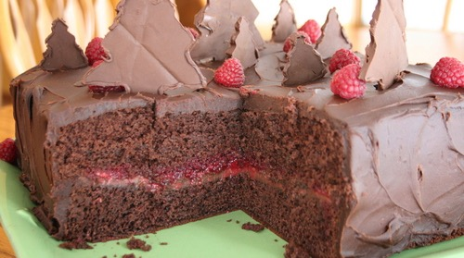
You want bread? Then eat cake!
Marie Antionette

Slide 3
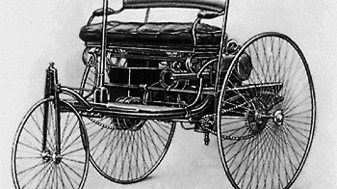
Want a car? Get a Benz .
Karl Benz

Slide 4
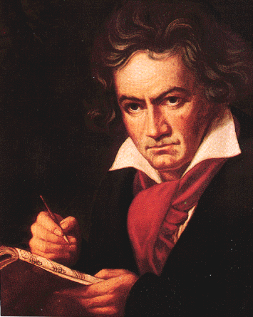
Can’t hear you, or my music.
Ludwig van Beethoven

Slide 5
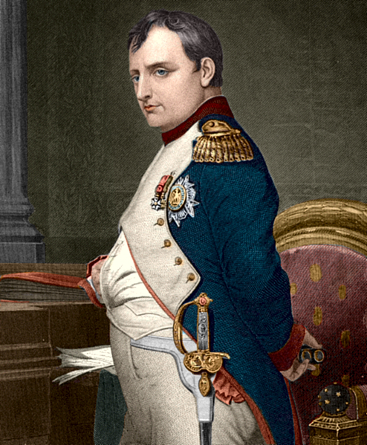
A large empire, and large mistakes.
Napoleon Bonaparte

Slide 6
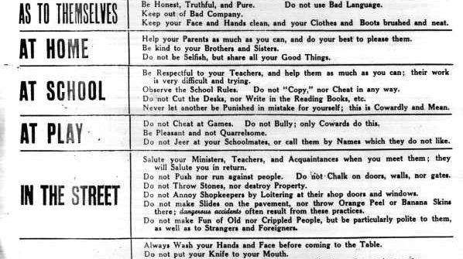
Manners, skills, learning, morals, and virtues.
Baldassare Castiglione

Slide 7
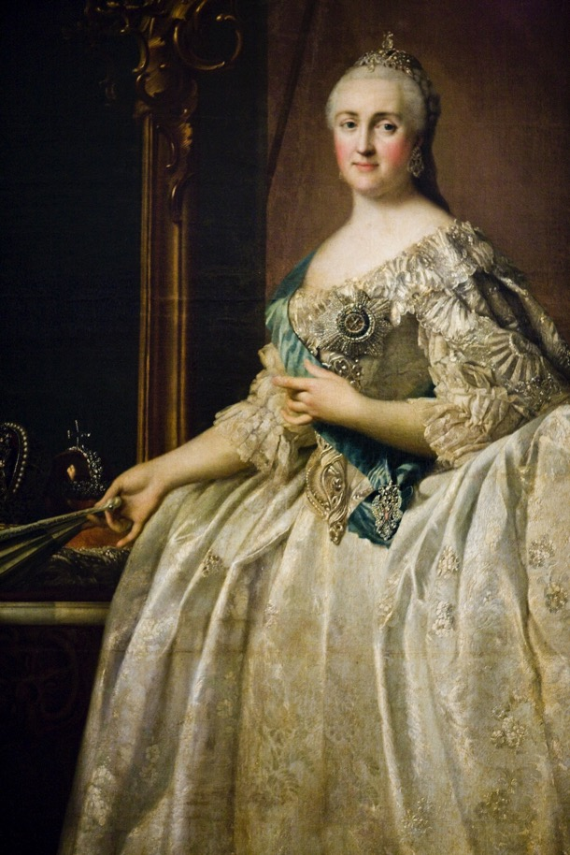
Above all she loved the truth.
Catherine the Great

Slide 8
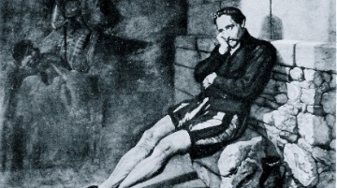
He wrote, fought, and was imprisoned.
Miguel de Cervantes

Slide 9
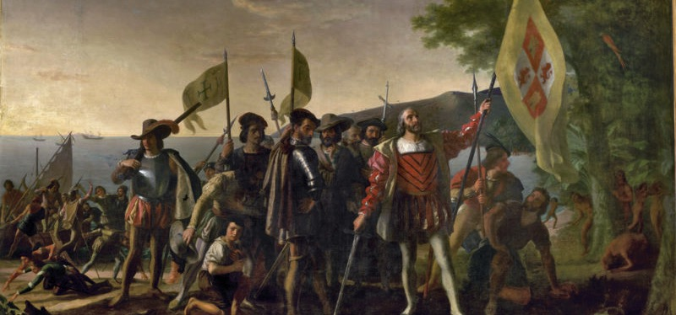
He accidently found it on purpose.
Christopher Columbus

Slide 10
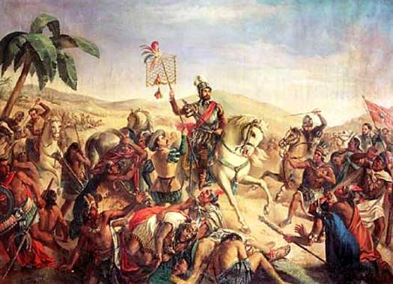
Gold. Death. Gold. More death. Gold.
Hernando Cortez

Slide 11
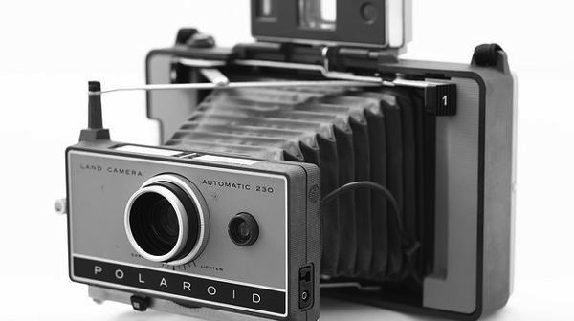
Photographers should be thankful for me.
Louis Daguerre

Slide 12
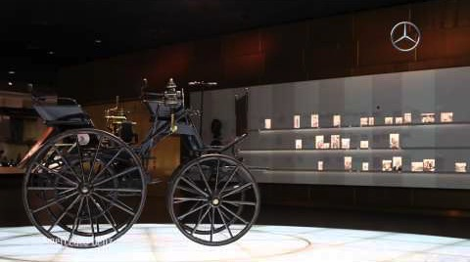
That’s right, it was my idea.
Gottlieb Daimler

Slide 13
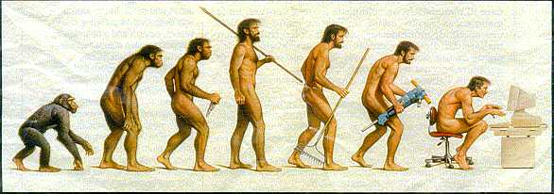
Yup, that’s evolution for you, alright.
Charles Darwin

Slide 14
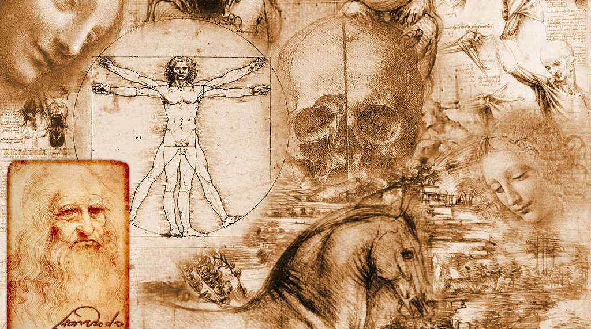
A genius; embodies the Renaissance ideal.
Leonardo da Vinci

Slide 15
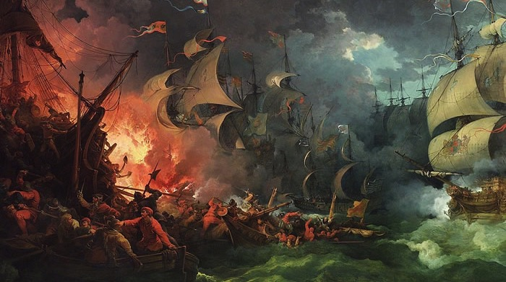
Size doesn’t matter now does it?
Francis Drake

Slide 16

Brightening the world, bulb by bulb.
Thomas Edison

Slide 17
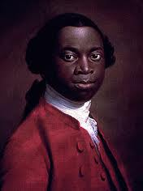
Watching the hurt in my people.
Olaudah Equaino

Slide 18
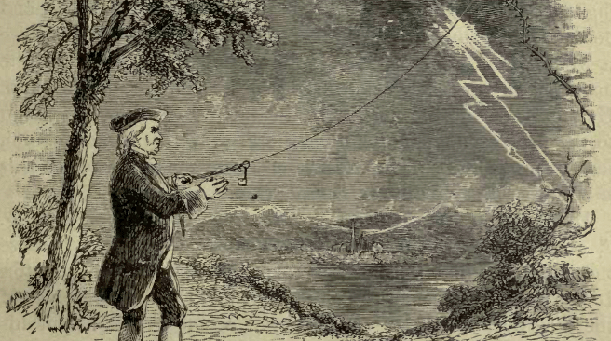
The key to electricity; my key.
Benjamin Franklin

Slide 19
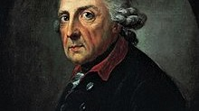
I didn’t want to command soldiers.
Frederick II

Slide 20
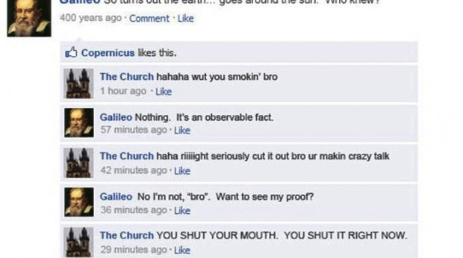
I got tried because I’m right.
Galileo Galilei

Slide 21
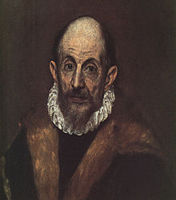
Born Greek. Master of Spanish painting.
El Greco

Slide 22
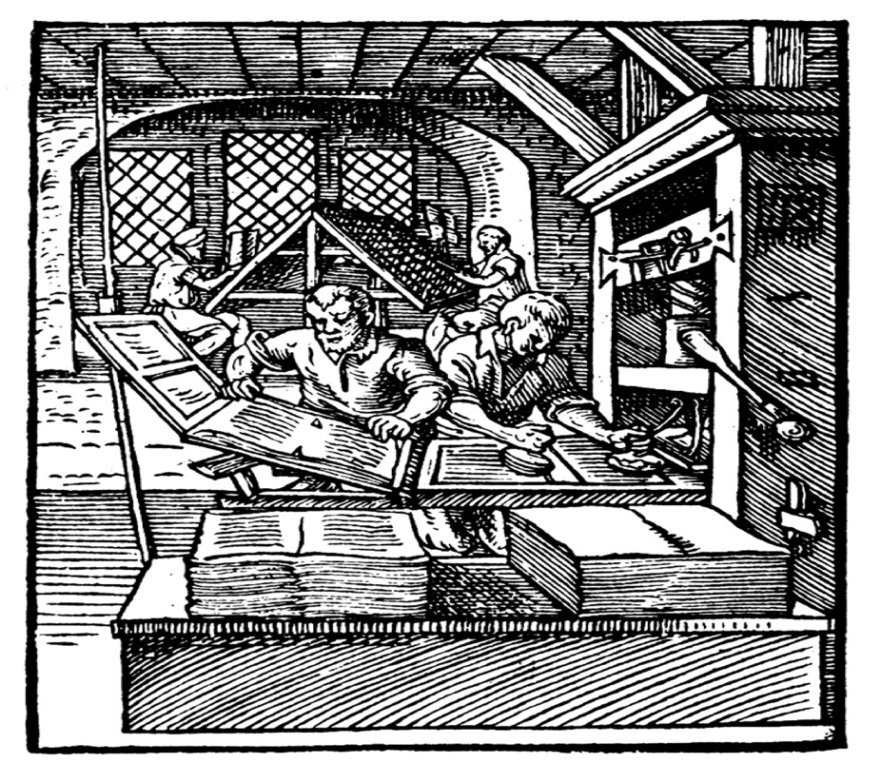
Really liked to move letters around.
Johann Gutenberg

Slide 23
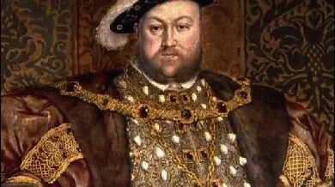
Changed the Church for a son.
Henry VIII

Slide 24
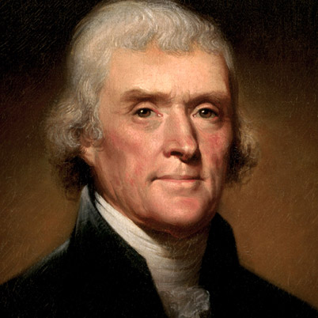
Pretty much wrote Declaration of Independence.
Thomas Jefferson

Slide 25
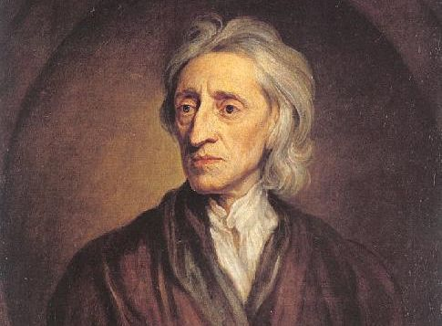
I swear these pedestrians don’t think.
John Locke

Slide 26
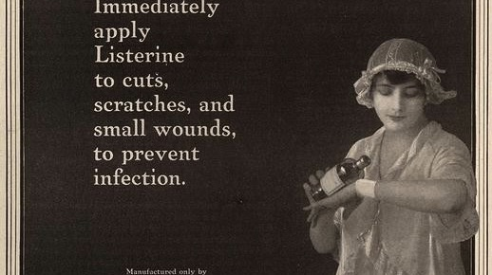
Be clean. Use antiseptic. Discovered it.
Thomas Lister

Slide 27
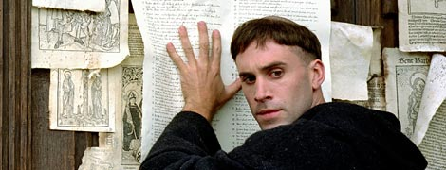
Didn’t like system. Made 95 corrections.
Martin Luther

Slide 28
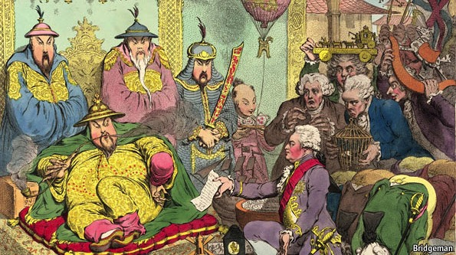
Meant well, still caused a war.
Lord Macartney

Slide 29
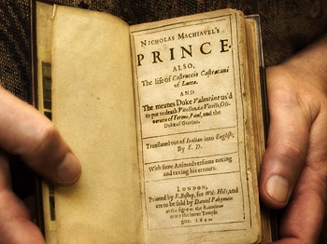
Liked power, even wrote a book.
Niccolò Machiavelli

Slide 30
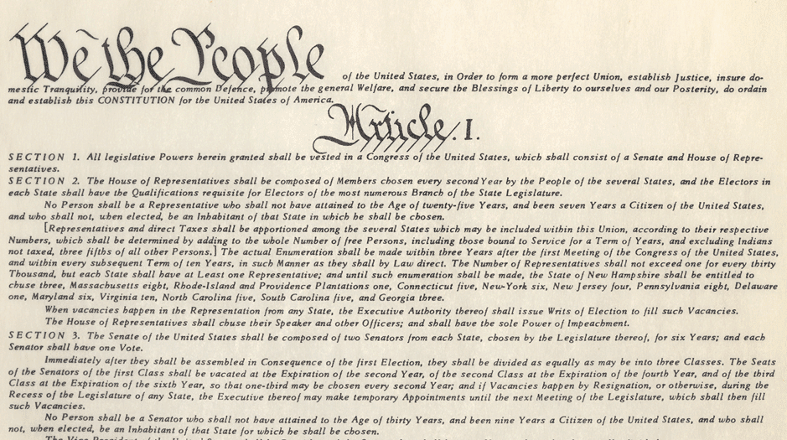
That’s right son, it’s my boy.
James Madison

Slide 31
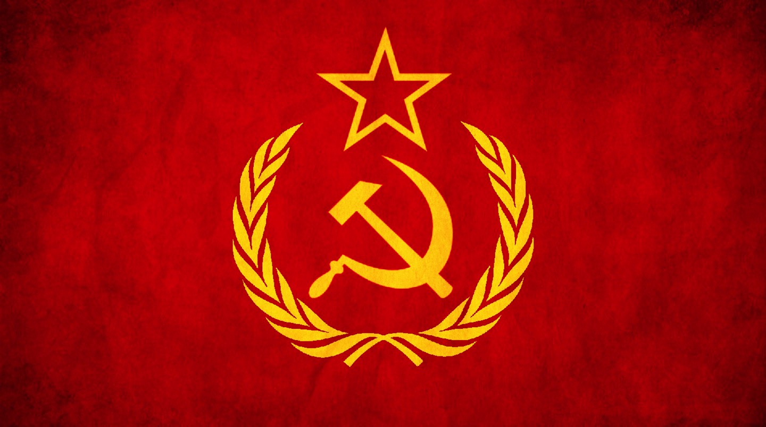
I only need one word, Unite!
Karl Marx

Slide 32
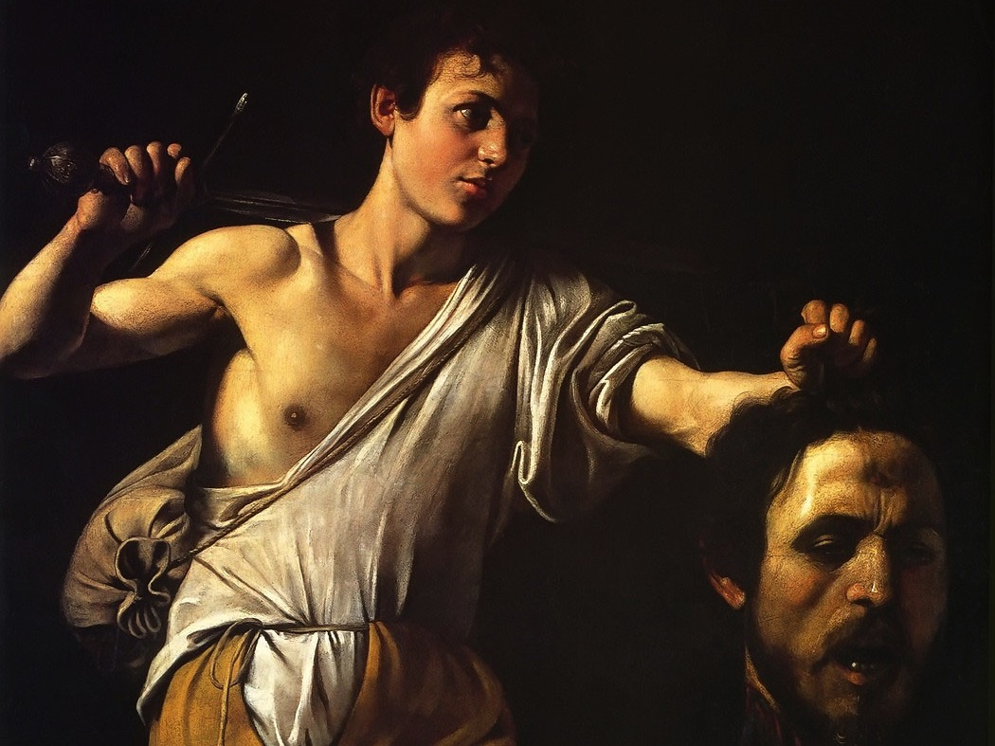
Great artist, with an anger problem.
Michelangelo Caravaggio

Slide 33

Music pieces made me a genius.
Mozart

Slide 34
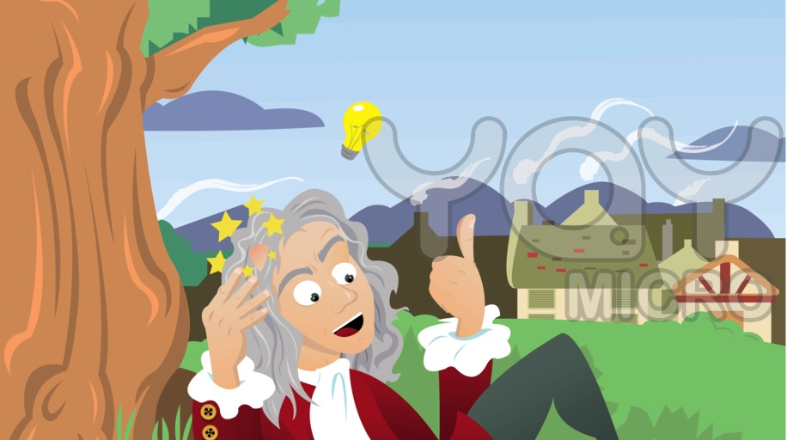
The apple hit him just right.
Issac Newton

Slide 35
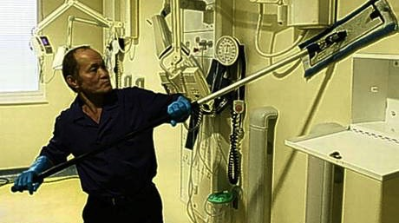
Sanitation, it is important you know.
Florence Nightingale

Slide 36
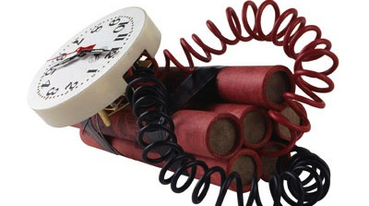
Made for construction, still kills people.
Alfred Nobel

Slide 37
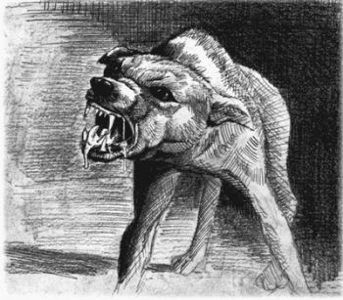
Did horrible things to all dogs.
Louis Pasteur

Slide 38
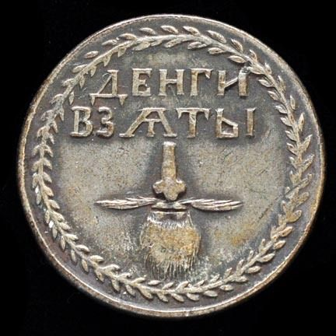
Shaved a beard, changed the world.
Peter the Great

Slide 39
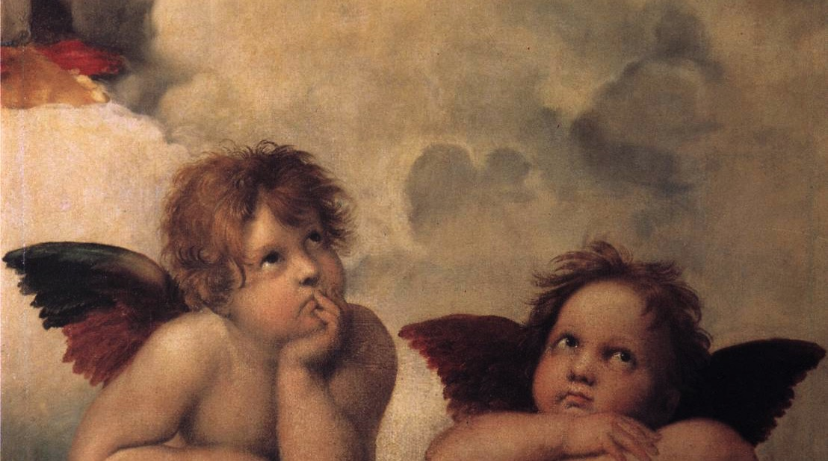
Painting about angels was my idea.
Raphael

Slide 40
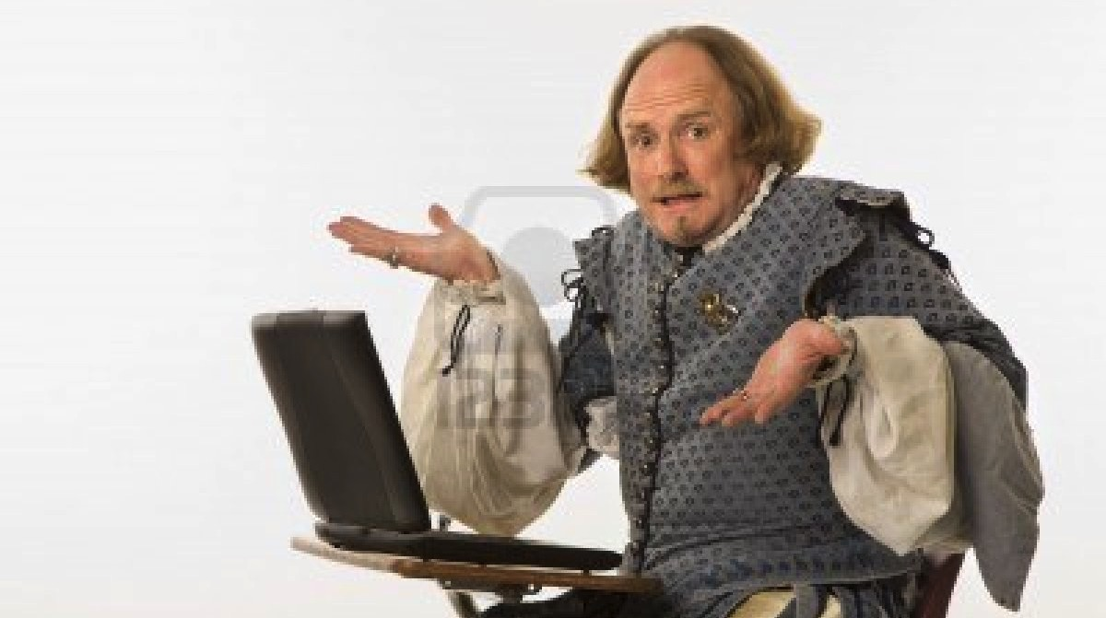
Bard wrote the tales of old.
William Shakespeare

Slide 41
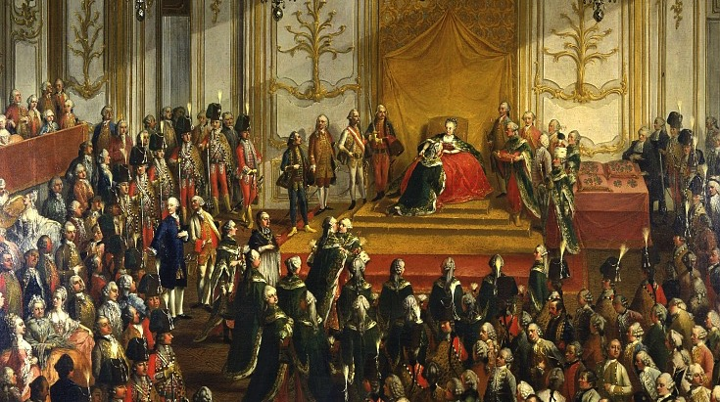
Any moment problems can take flight.
Maria Theresa

Slide 42
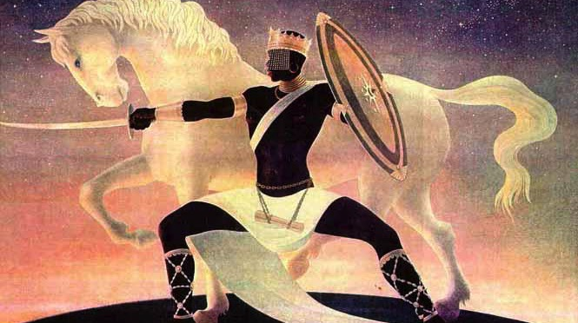
Needed power, so became a god.
Osei Tutu

Slide 43
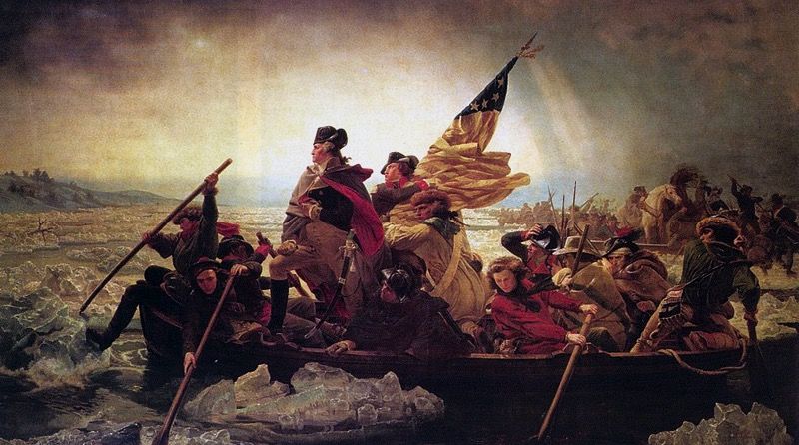
Lost battles, but won the war.
George Washington

Slide 44
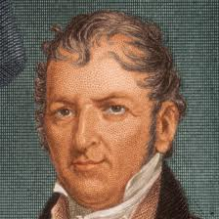
Created the famous cotton gin. Great!
Eli Whitney

Slide 45
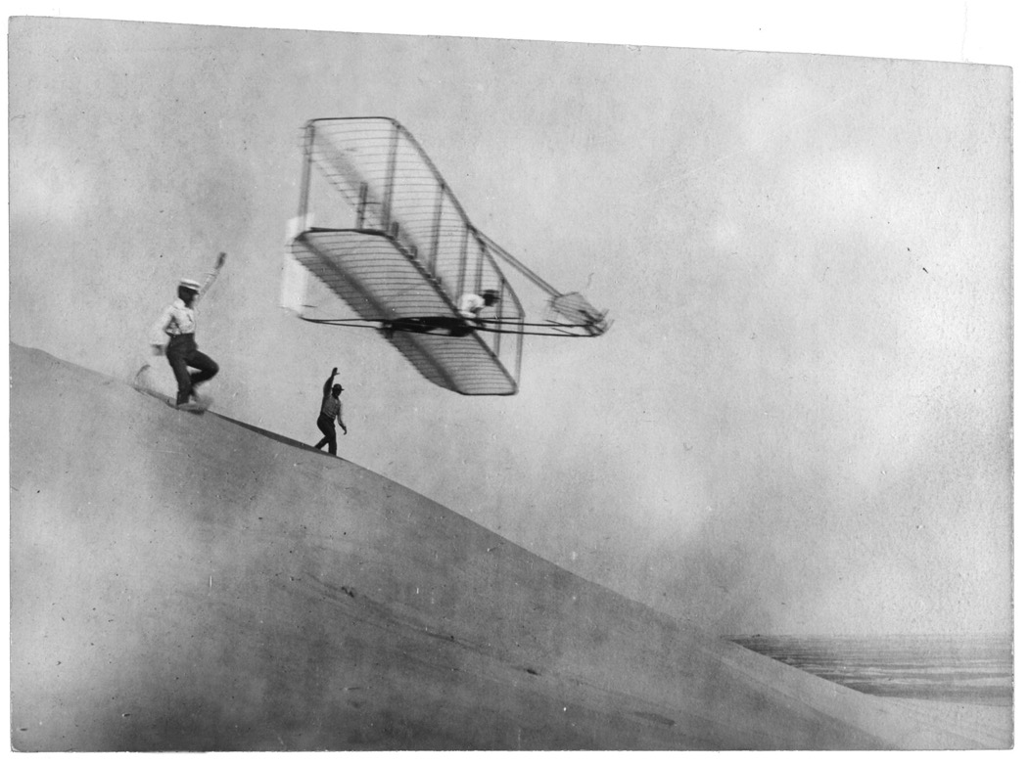
You gotta be wright if you wanna fly.
Wright Brothers

Slide 46
The End.

